Slide 1


Interacting with the Map View
Esri Developer Summit
March 8–11, 2016 | Palm Springs, CA
Chris Fox

Slide 2

MapView
Represents a view of a map (2D) or a scene (3D).
Primary interface for interacting with a map or scene.
There can be multiple MapViews open in the application.
Only one active MapView.

Slide 3
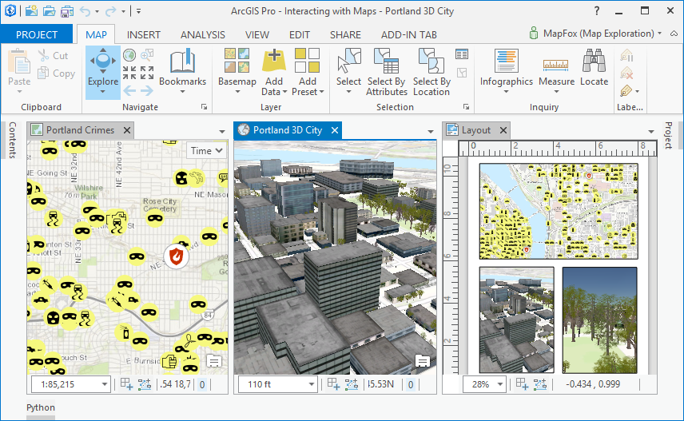
MapView
1
2
3
4
5

Slide 4
Active MapView
ArcGIS Pro is contextual.
Ribbon tabs and commands respond to the active view.
MapView.Active
Static property that returns the active map view in the application.
Can be null if there is no active map view.
var mapView = MapView.Active;
if (mapView != null)
{ ......
Notes:
You can activate the pane containing the map you want to become active view. Can’t set .active directly.

Slide 5
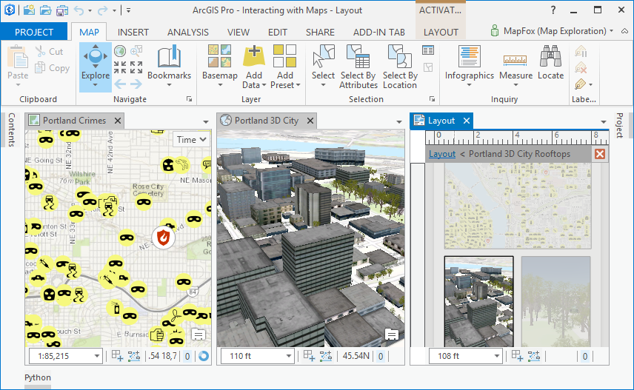
Active MapView
Active
Active

Slide 6
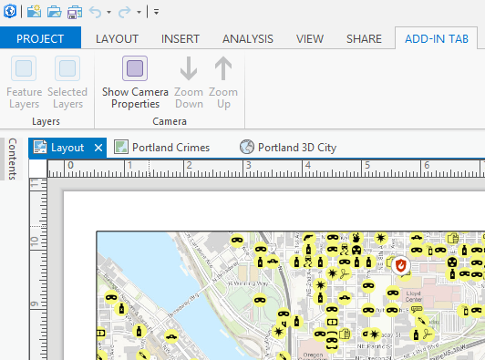
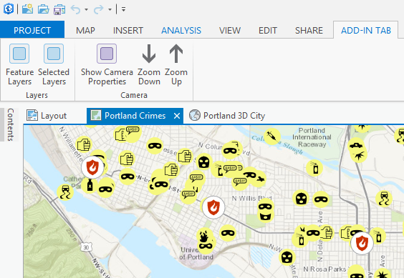
esri_mapping_mapPane condition
Notes:
Can control enabled state of controls depending on which mapview is active.

Slide 7
MapView.ViewingMode
MapViewingMode enumeration
Map: Data is displayed on a 2D surface, only valid for 2D Maps.
SceneLocal: Data is projected on to a surface, only valid for 3D Scenes.
SceneGlobal: Data is projected on to a spherical globe, only valid for 3D Scenes.
var mapView = MapView.Active;
bool is2D = (mapView.ViewingMode == MapViewingMode.Map);

Slide 8
MapView.Map
Read-only property returns the Map being visualized in the View.
Get from active MapView to return the active map.
Map.Layers returns a collection of the layers in the Map.
var mapView = MapView.Active;
if (mapView != null)
return;
var activeMap = MapView.Active.Map;
var featureLayers = activeMap.GetLayersAsFlattenedList()
.OfType<FeatureLayer>();

Slide 9
Contents Pane
The Contents pane is another common way context is set in the application
Selected Item: Feature Layer, Raster Layer, Standalone Table
MapView provides the ability to get and set this context
var layers = mapView.GetSelectedLayers();
bool areAllFeatureLayers = layers.All(l => l is FeatureLayer);
Notes:
E.G. set which tabs are active/enabled depending on when layer is selected in TOC.

Slide 10
Camera
Defines the display content of a view via its:
Viewing Location: X,Y, Z, Scale
Viewing Direction: Heading/Yaw, Pitch and Roll
2D: X,Y, Scale, Heading/Yaw
3D: X,Y, Z, Heading/Yaw, Pitch, Roll
var camera = mapView.Camera;
camera.Pitch = 45.0;
mapView.ZoomToAsync(camera);
Notes:
Essentially the POV.

Slide 11
Extent
Calculated by camera and aspect ratio of the View.
2D: represents the bounding box in the View.
3D: represents the viewing area of interest.
var extent = mapView.Extent;
var newExtent = GeometryEngine.Expand(extent, 1.5, 1.5, true);
mapView.ZoomToAsync(extent);
Notes:
Only makes true sense in 2D. Oblique angles make it tricky.

Slide 12
Navigation and Interaction
Same methods for 2D and 3D
SelectFeatures, GetFeatures (Can also support 3D selections)
Overloaded ZoomToAsync and PanToAsync
var mapView = MapView.Active;
var selection = mapView.SelectFeatures(geometry);
mapView.ZoomToAsync(selection);

Slide 13
MapTool
Base class representing a tool to perform interactive operations with a MapView.
Used to create custom tools for Selection, Identify, Editing, etc.
Provides virtual methods for Keyboard and Mouse Events
Provides properties to set default behavior of left-click to create a sketch.
Virtual SketchComplete and SketchCancelled methods.
Notes:
Return e.Handled = true from OnToolMouseDown and OnToolMouseUp to also handle Asynchronous flavors of MouseDown and MouseUp: HandleMouseDownAsync and HandleMouseUpAsync

Slide 14
SketchTool
.
class SketchTool1 : MapTool
{
public SketchTool1()
{
IsSketchTool = true;
SketchType = SketchGeometryType.Rectangle;
SketchOutputMode = SketchOutputMode.Map;
}
protected override Task<bool> OnSketchCompleteAsync(Geometry geometry)
{
return base.OnSketchCompleteAsync(geometry);
}
}
Notes:
SketchOutputMode can be .Map or .Screen; some tools only work in .Screen (e.g. selection, identify)
MapView.SelectFeatures and MapView.GetFeatures throw a System.ArgumentException if a 3D query is attempted in SketchOutputMode.Map
Tool demo
Note: If you don’t set IsSketchTool = true you do not get a sketch on the view

Slide 15
Embedded Control
WPF User Control associated with a MapTool
Update the “esri_embeddableControls” category in Config.daml
DAML follows same Pro MVVM pattern
<categories>
<updateCategory refID="esri_embeddableControls">
<insertComponent id="AttributeToolOverlayControl_EmbeddableControl"
className="OverlayControlViewModel">
<content className="OverlayControlView" />
</insertComponent>
</updateCategory>
</categories>

Slide 16
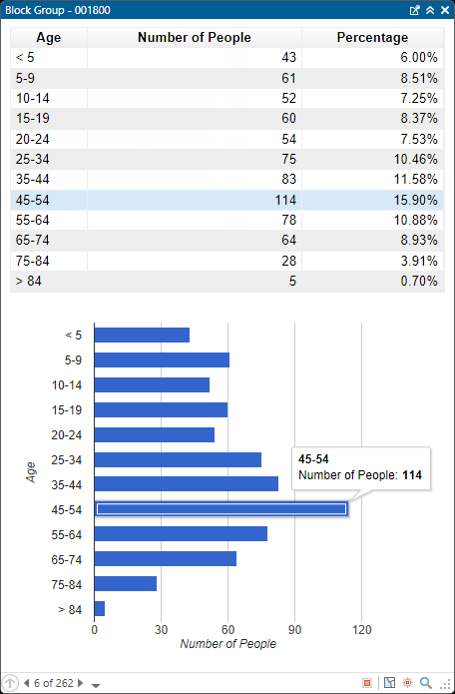
Pop-ups (new at 1.2)
{
var htmlPath = Path.Combine(
Path.GetDirectoryName(System.Reflection.Assembly.
GetExecutingAssembly().Location), "template.html");
var html = File.ReadAllText(htmlPath);
//Update the template with our custom html
html = html.Replace("//data.addColumn", sb.ToString());
var popupContent = new PopupContent(html, title);
MapView.Active.ShowCustomPopup(new List<PopupContent> {popupContent});
}

Slide 17
Animation (new at 1.2)
Composed of Tracks and Keyframes
Keyframe can store camera, layer visibility, map time and range
Transitions define the method used to interpolate values between Keyframes
For example how the camera moves from A to B
{
var mapView = MapView.Active;
var animation = mapView.Map.Animation;
var cameraTrack = animation.Tracks.OfType<CameraTrack>().First();
cameraTrack.CreateKeyframe(mapView.Camera, TimeSpan.FromSeconds(3),
AnimationTransition.FixedArc);
}

Slide 18
Events
Global events available for MapView
ActiveMapViewChangedEvent
DrawStartedEvent and DrawCompleteEvent
MapViewCameraChangedEvent
Demo

Slide 19




